Slide 1
CZ1003 Project Assessment
Bryan Lim Choon Kiat
Carissa Odelia Lim
James Elijah Braganza Morillo

Slide 2
Content
Team’s Contribution & Software Usage
Program Design (Flow-chart of Top Level)
How the Programming was done (show all requirements of rubrics)
Program Testing
Demo

Slide 3
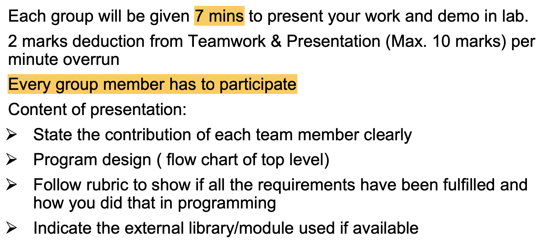

Slide 5
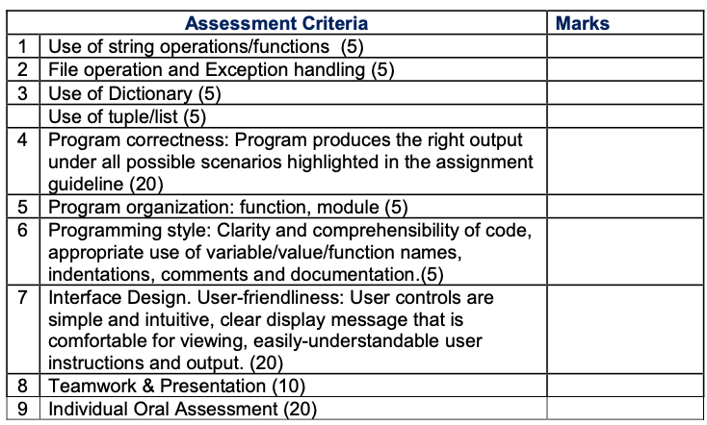

Slide 6
01
Team’s Contribution
& Program Usage

Slide 7
Team’s Contribution
Name
Carissa | Created Program (Login-Sign-Up) Added DOB-integer check (Login-Sign-Up) Added Game-command for Gameplay screen (Login-Sign-Up)
Bryan | Added PW verification (Login-Sign-Up) Added number of tries support (Login-Sign-Up) Created gameplay grids-layout & ship placement grids-layout (Gameplay) Supported in gameplay algorithms (Gameplay) Placement of ships Recording of coordinates for win lose condition
James | Battleship gameplay turn based algorithm and architecture Battleship Data Management with the use of Dictionary & Tuples Battleship Scatter shot Random Placement of AI Carrier and Submarine Random Firing of AI Game update Pop-ups Win Lose Condition Improved User Interface (added explosion when hit) End Prompt (Quit or Play Again)

Slide 8
Software Usage
Python 3 using tkinter module
Use of Github for collaborative coding
Use of PIL Package to animate explosion when a ship is hit

Slide 9
02
Program Design
(flowchart)

Slide 10
Program Design
Will be discussed further in programme testing section
False
password meets criteria?
Start
Sign-Up
Input new username, password, DOB
True
True
All 3 fields completed?
Login
False
True
False
Username exist in list?
DOB info correct?
True
False
End
Store information in list

Slide 11
Program Design
Start
Sign-Up
False
Username and Password matches list?
False
Username exist in list?
Login
Input username & password
True
True
Count = 0
Login User
Count = 0
Count += 1
End
True
Matches list’s DOB and username?
Open Load/New game screen
Count < 3?
False
True
Input DOB
Inactivates Account
False

Slide 12
Program Design
False
carrier placed on surface with all 4 units within grid?
False
True
True
Start (after login)
Open New Game Screen
Carrier underwater?
Place carrier boat
User select on grid to place carrier
Disable selected buttons
End
User select on grid to place submarine
Open gameplay screen
False
Submarine underwater?
Disable selected buttons
Random placement of AI submarine and carrier on AI's board
True
False
On surface with all 3 units within grid?
Underwater All 3 units within grid?
True
False
Submarine overlaps with carrier?
Place Submarine boat
False
True
True
Notes:
Submarine overlaps with carrier?

Slide 13
Tile chosen already shot?
Apply Scatter shot and then update Board color
Program Design (Game play)
False
Tile Hit?
True
Show message "You already shot here!"
True
Show message that player hit AI ship.
False
Open New Game Screen
Player Start (Default) & Chooses tile to shoot
Tile Belongs to Player?
Show message player missed
False
AI Turn & Chooses a random tile, prints target in kernel
Player Score +1, Player score = 7?
Start
Message:
cannot shoot own board
False
Show AI hit or miss player's ship
True
End
AI Score +1, AI score = 7?
True
True
False
Tile already shot?
Show "You Won"
False
Show "Bot Won"
True
End

Slide 14
03
Programming

Slide 15
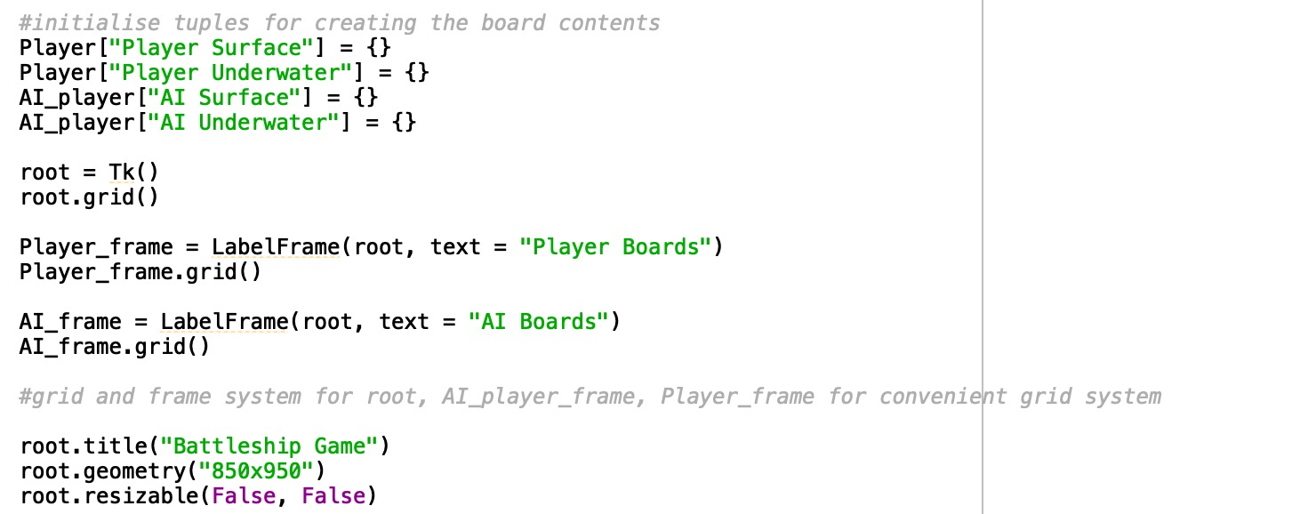
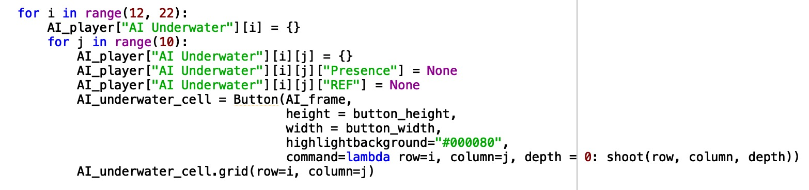
Programming (Initialising 4 Boards)
Create 2 frames within the gameplay window, then initialized them into grids to work with them more conveniently:
Player_frame
AI_frame
Initialized Player and AI Boards into a Dictionary
Used Dictionary to give grid system information, crucial for identifying the ["Presence"] of shot in each tile. Also used ["REF"] assigned for Refereeing the overall scoring system

Slide 16
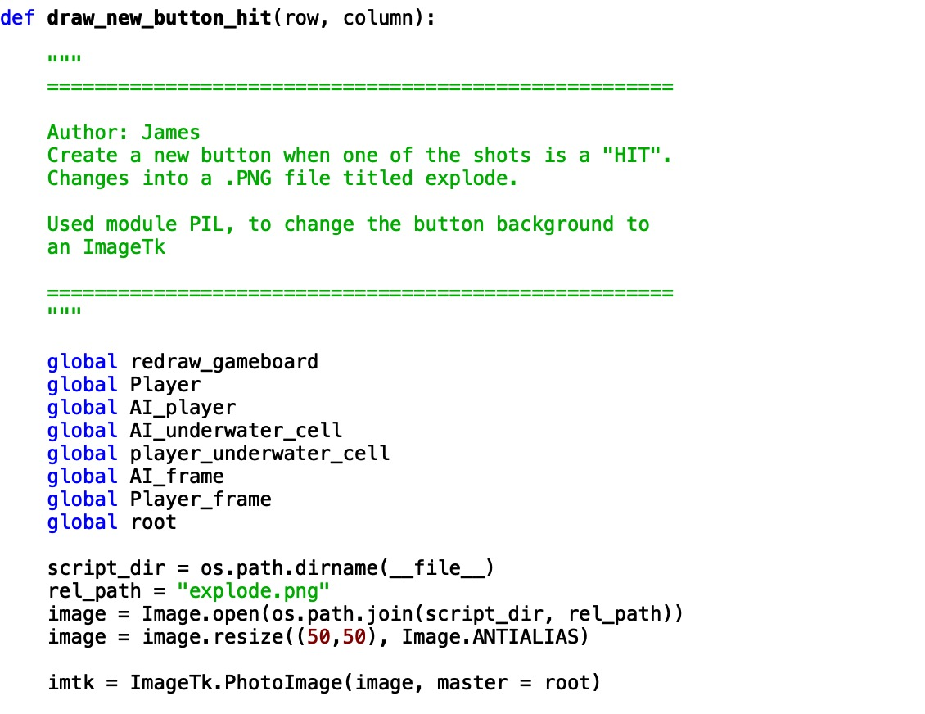
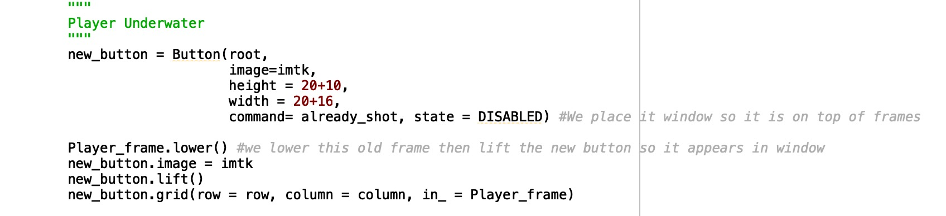
Programming
Create functions for a hit shot and a missed shot, in here we used file operation using os.path.dirname(__file__) which finds the file within the same folder of the .py
New button is introduced when it is a hit and are arranged on top of the frames so that it can be seen.
We also used another external Package PIL to use ImageTk.PhotoImage and insert this image into the buttons

Slide 17
Programming (Scatter shots)
Scatter Shot requires special treatments and is different for each different corners, and boundary.
When not in a boundary, it is a standard 9 shots with the target in the centre.
In a typical corner, it is only 4 shots. Hence we had to develop for all cases

Slide 18
Programming (AI)
The AI in the game is immediately executed after the player makes a valid move.
It shoots randomly and has no intelligence.
AI placing is made only horizontal
AI Turn function will keep running until its target coordinate is a valid target, meaning it is not a tile that is already Hit.

Slide 19
04
Program Testing

Slide 20
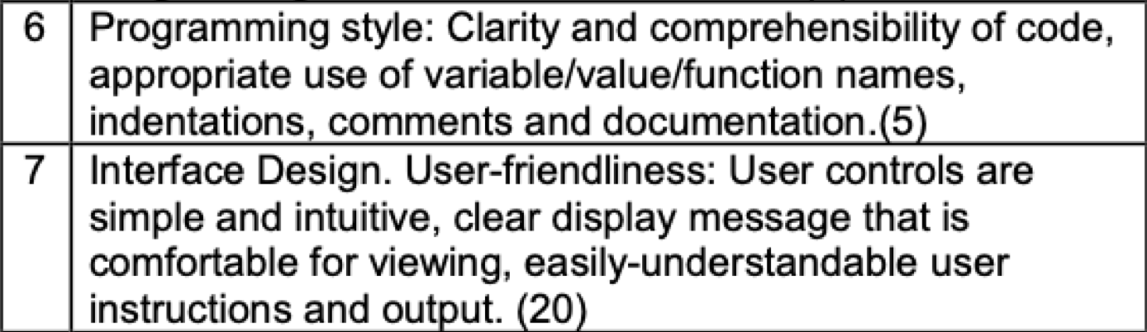
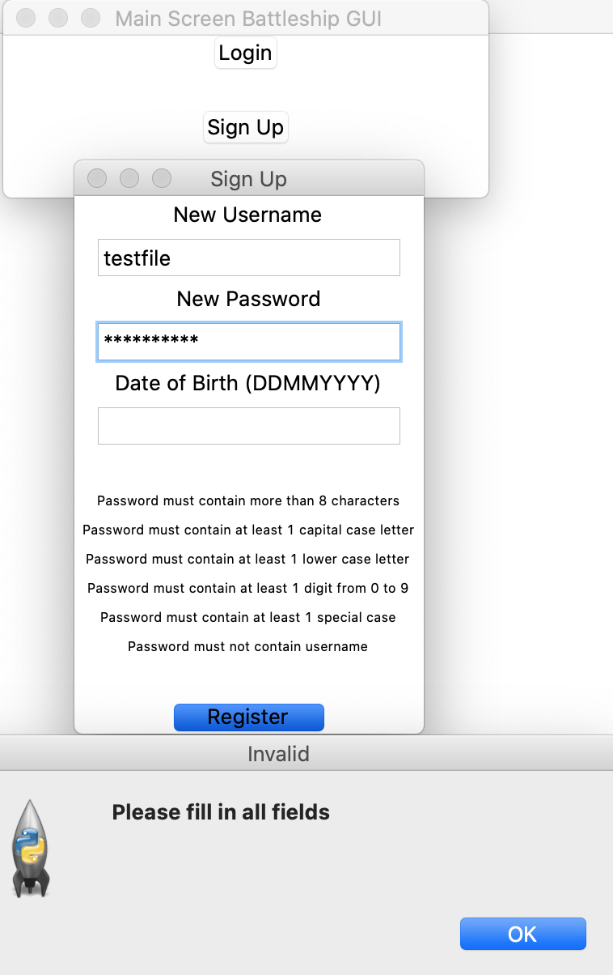
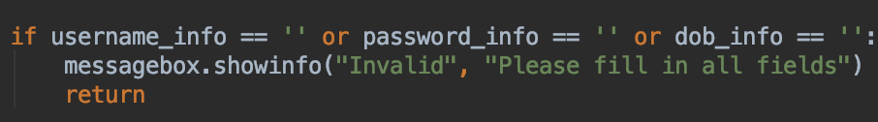
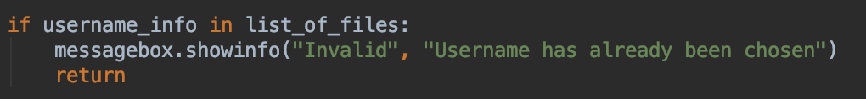
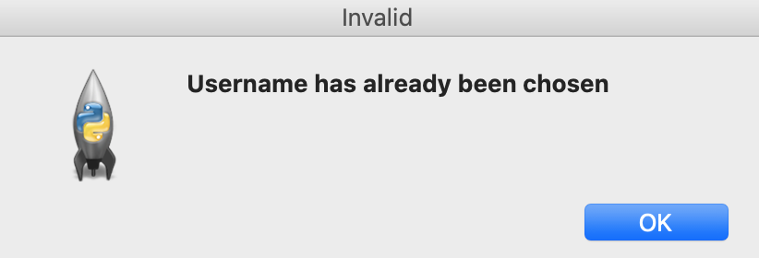
Program Testing (Login-Sign Up)
Did not fill in all fields during Sign-Up
Sign-Up Username with existing Account

Slide 21
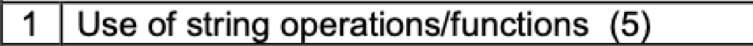
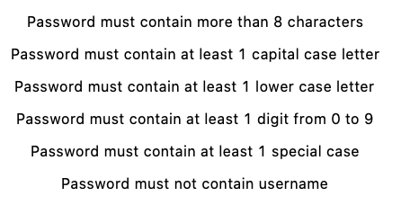
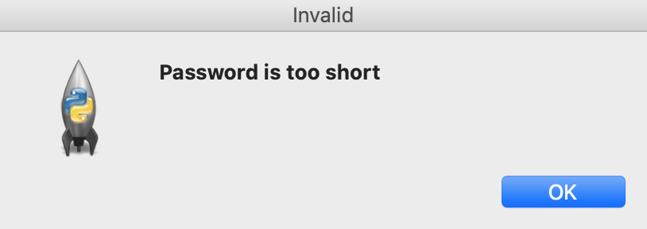
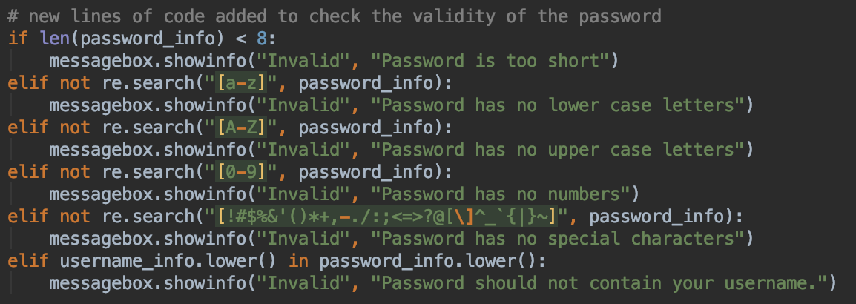
Program Testing (Login-Sign Up)
3. Password Criteria for Sign-Up (String-Operation)

Slide 22
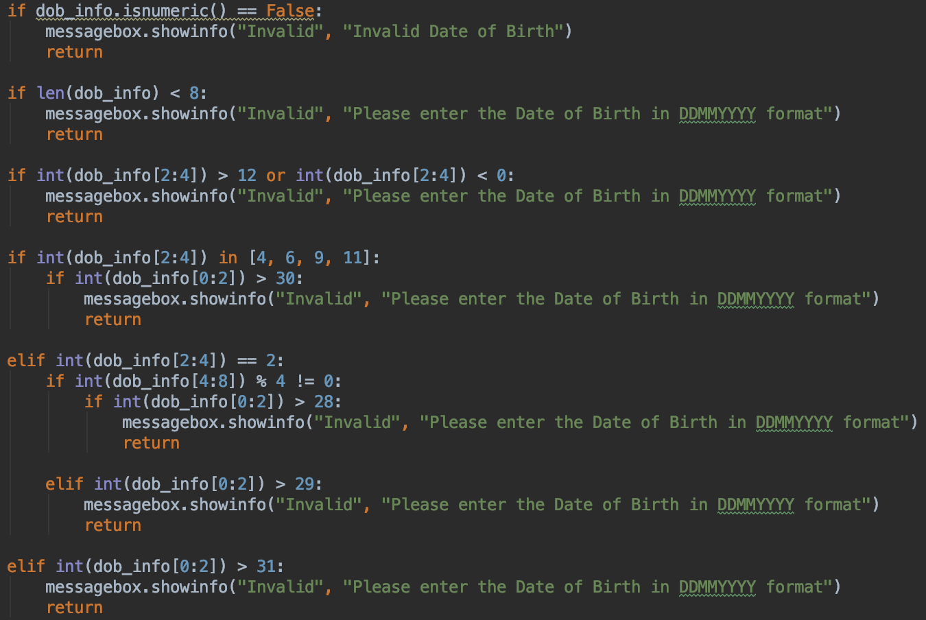
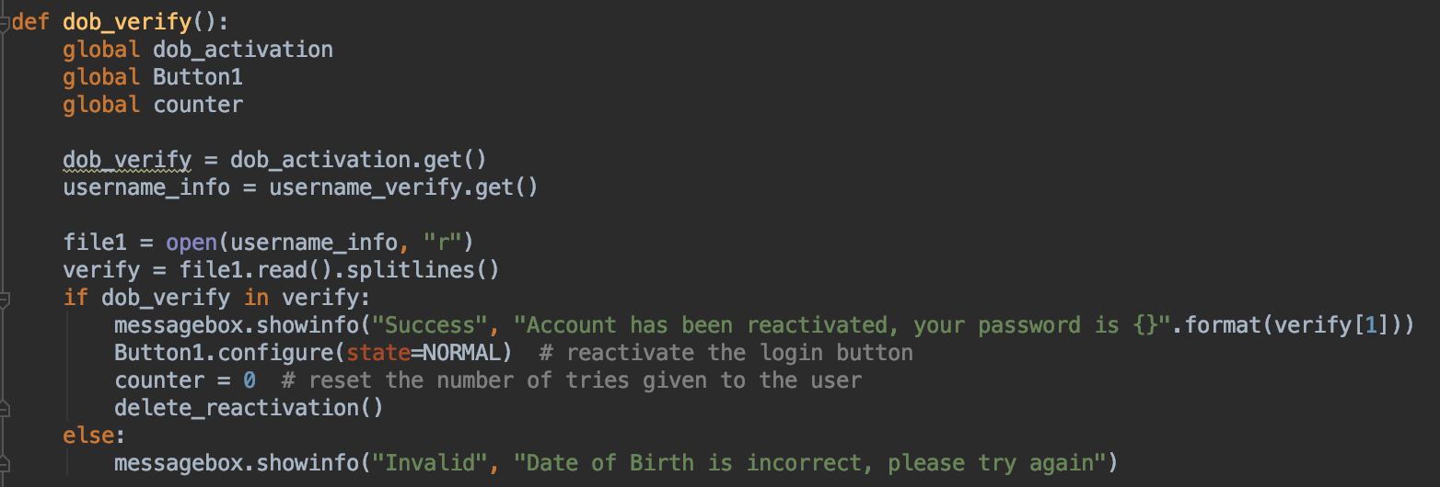
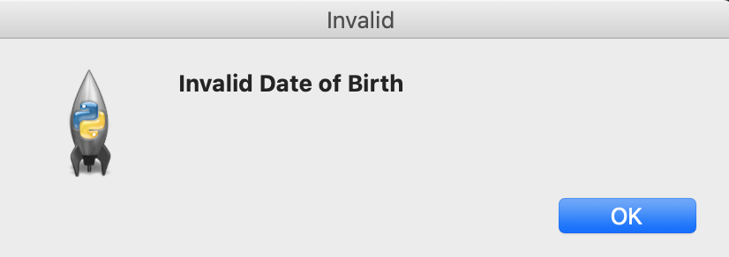
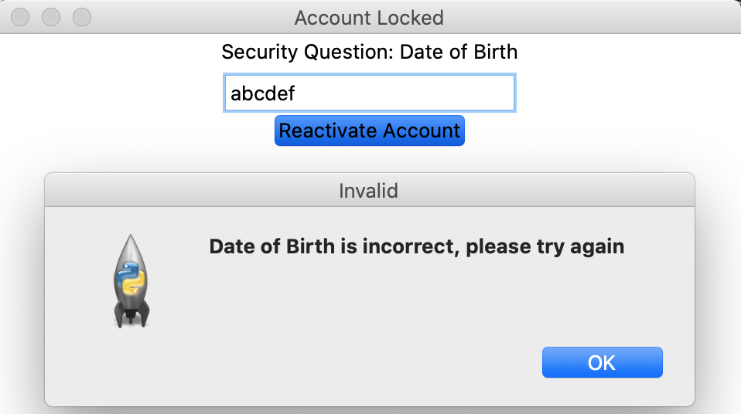
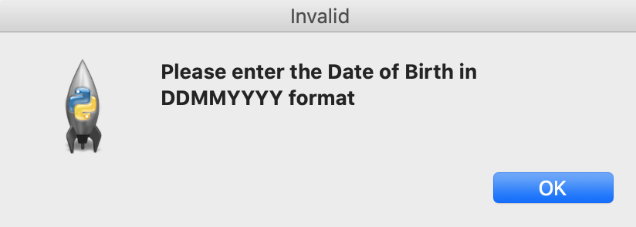
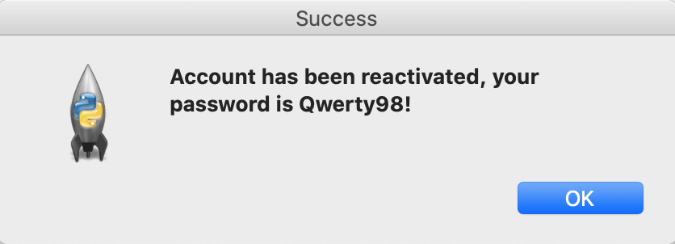
Program Testing (Login-Sign Up)
4. Entering Date of Birth for Sign-Up and Unlocking Account

Slide 23
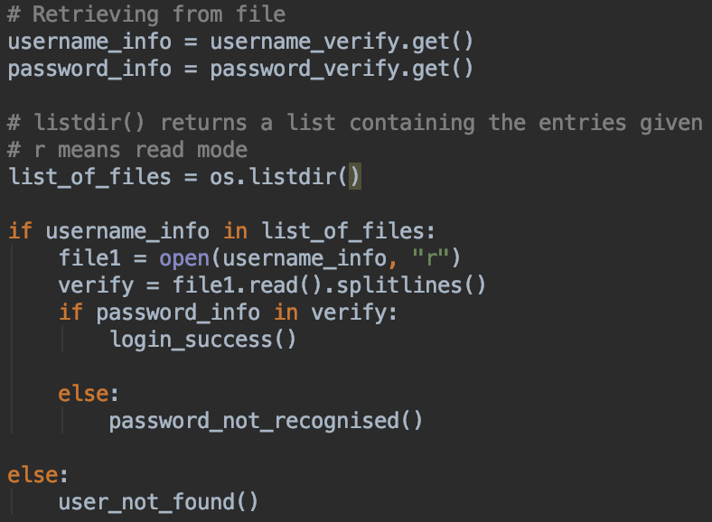
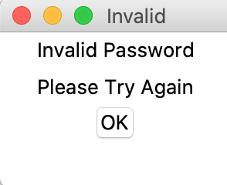
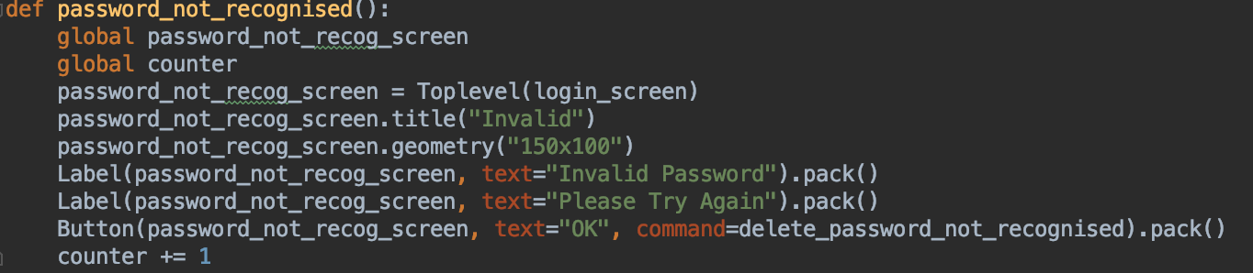
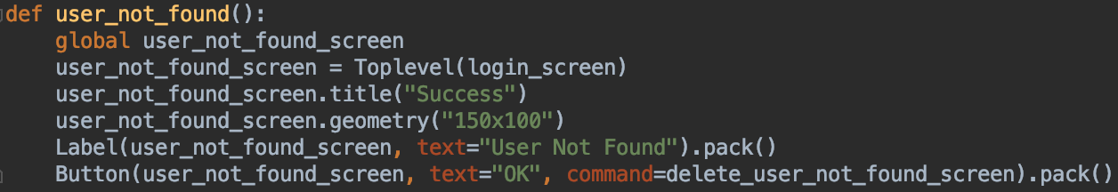
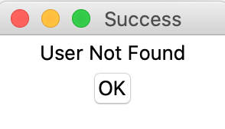
Program Testing (Login-Sign Up)
5. Verifying during Login

Slide 24
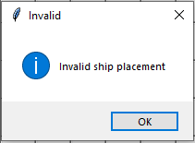
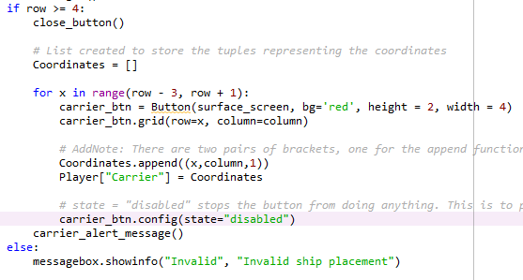
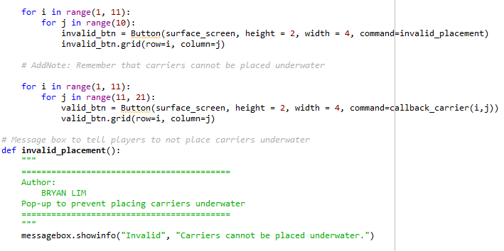
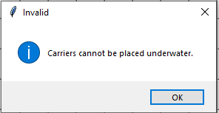
Program Testing (Ships)
1. Invalid Ship Placement on grids

Slide 25
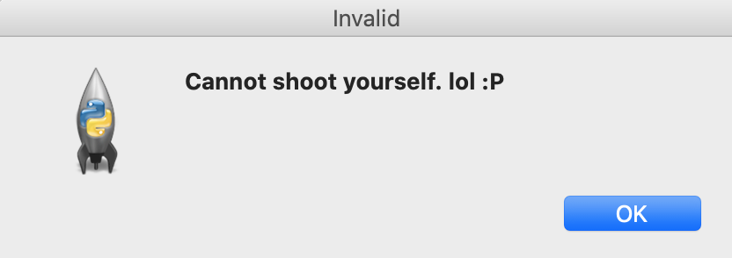
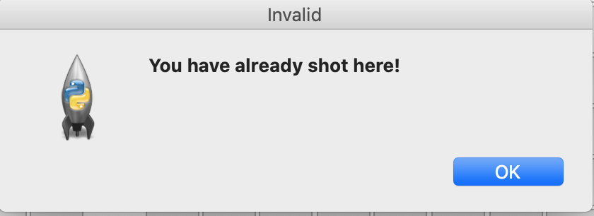
Program Testing (Gameplay)
Error-handling cases
All possible scenarios :
1. Shots in Player Boards will pop up an invalid
message "cannot shoot yourself."
2. Shooting a "shot" tile also returns an
Invalid message.
3. AI turn is based to run after the Player executed a valid turn, else it is still Player's turn.

Slide 26
05
Demo

Slide 27
False
carrier placed on surface with all 4 units within grid?
False
True
True
Start (after login)
Open New Game Screen
Carrier underwater?
Place carrier boat
User select on grid to place carrier
Disable selected buttons
End
User select on grid to place submarine
Open gameplay screen
False
Submarine underwater?
Disable selected buttons
Random placement of AI submarine and carrier on AI's board
True
False
On surface with all 3 units within grid?
Underwater All 3 units within grid?
True
False
Submarine overlaps with carrier?
Place Submarine boat
False
True
True
Notes:
Submarine overlaps with carrier?

